Slide 1

CS-0401
INTERMEDIATE PROGRAMMING
USING JAVA
Prof. Dr. Paulo Brasko Ferreira
Spring 2018

Slide 2
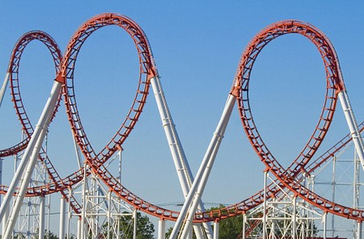
Chapter 4
Loops and Files

Slide 3
Chapter 4 Presentation Outline
First Part: Loops
  The increment and decrement operators
  The while Loop
  The do-while Loop
  The for loop
  Nested loops
  The break and continue statements
Second Part: File Input and Output (if time allows)
  Introduction to File Input and Output
  Java Exceptions

Slide 4
First Part:
Loop Structures

Slide 5

The While Loop

Slide 6
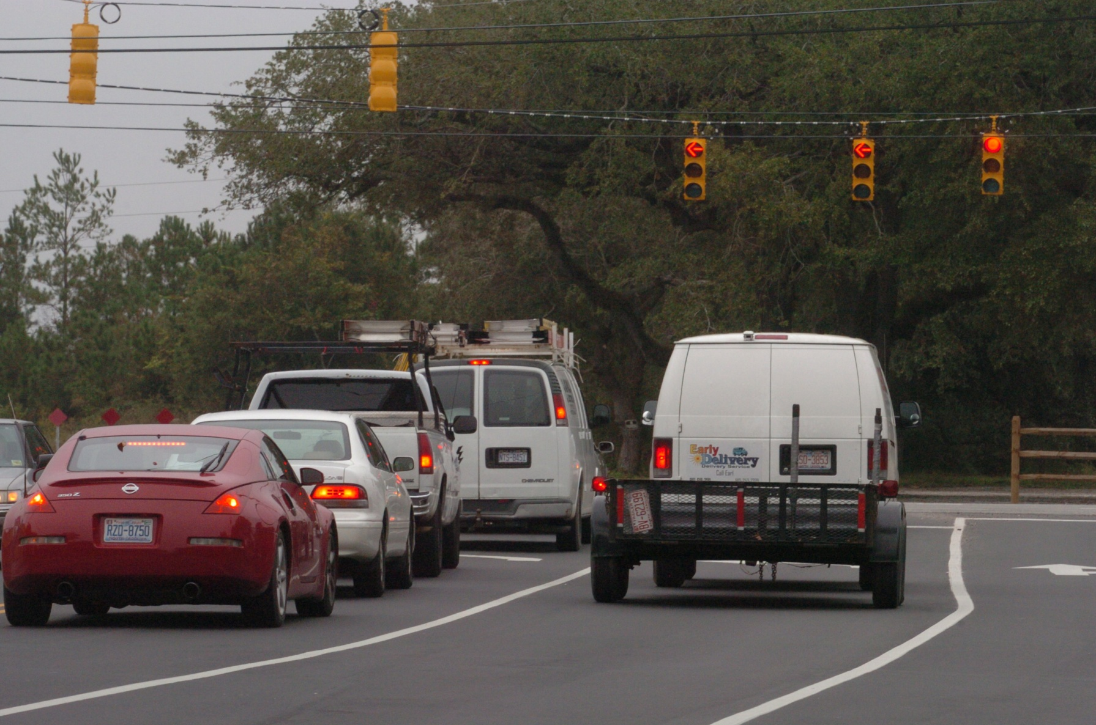
The While Loop
https://www.youtube.com/watch?v=mRD5JCcjHrw&list=PL8071DACE30D40170
2012 Presidential Towers Stair Climb - Reference Video

Slide 7
The While Loop
  While Loop Syntax:
  while(boolean condition is true) {
  execute commands inside
  }
  Example:
  int currentFloor = 10;
  int topFloor = 50;
  while(currentFloor < topFloor) {
    System.out.println(“Almost there! Floor: “ + currentFloor);
    currentFloor = currentFloor + 1;
  }
  System.out.println(“Finally here! Top floor!”);

Slide 8

The While Loop
The while loop is normally used when we do not know a priori when to stop
We need to check the status of a given condition
If the condition is true, execute the while loop body contents
If the condition is false, terminate the WHILE loop
The first check is performed BEFORE executing lines inside the loop.

Slide 9

While Loop
Pay attention to infinite loops
int number = 0;
while (number <=5)
{
System.out.println(“Hello”);
number = number + 1;
}
What is wrong here ?

Slide 10
The “Guess the number” game

Slide 11
“Guess the number” game rules
We will make the program to randomly generates a number from 0 to 100 (with the Java API Random Class)
Then the program will keep asking the user to guess what the secret number is (with the Scanner/keyboard input)
If the user guess a lower number, the program gives a message to try a higher number, otherwise a lower number
When the user guess the right number, the program prints a message congratulating the user, shows how many guesses he/she took, and exits

Slide 12
The Do-While Loop

Slide 13
  The Do-While Loop Syntax:
      do {
      statement(s);
      } while (condition);
See TestAverage1.java

Slide 14
Increment and Decrement
Operators

Slide 15

Increment Operator
The following lines are equivalent!
  numberOfGuesses = numberOfGuesses + 1;
  numberOfGuesses += 1;
  numberOfGuesses ++;
Also these ones:
  nextEvenNumber = nextEventNumber + 2;
  nextEvenNumber += 2;

Slide 16
Decrement Operator
The following lines are equivalent!
  numberOfGuesses = numberOfGuesses - 1;
  numberOfGuesses -= 1;
  numberOfGuesses --;
Also these ones:
  nextEvenNumber = nextEventNumber - 10;
  nextEvenNumber -= 10;

Slide 17
Increment/Decrement Operators
They also work with multiplication and division
The following lines are equivalent!
  doubleIt = doubleIt * 2;
  doubleIt *= 2;
  fractionIt = fraction / 5;
  doubleIt /= 5;

Slide 18
The for loop

Slide 19
The for Loop
The for loop takes the form:
  for(initialization; test; update){
    statement(s);
  }
See Squares.java
See TotalSales.java

Slide 20
Nested Loops

Slide 21
Nested Loops
  Example:
  for(int i = 0; i < 3; i++) {
    for(int j = 0; j < 4; j++) {
      loop statements;
      }
      }
See Clock.java
  // how can we create this output?
  1 2 3 4
  5 6 7 8
  9 10 11 12

Slide 22
The break statement

Slide 23

The break statement
I want to allow only 10 guesses
int number = 5;
int myGuess = 4;
Scanner scan = new Scanner(System.in);
int numberOfGuesses = 0;
while (number != userGuess) {
System.out.println(“Enter your guess: ”);
int userGuess= scan.nextInt();
System.out.println(“Sorry, wrong number! Try again!”);
numberOfGuesses++;
}
System.out.println(“Great Job! You got it!”);
System.out.println(“It took “ + numberOfGuesses + “ guesses”);

Slide 24
The break statement
while (number != userGuess);
{
System.out.println(“Enter your guess: ”);
int userGuess= scan.nextInt();
System.out.println(“Sorry, wrong number! Try again!”);
numberOfGuesses++;
if (numberOfGuesses >= 10) {
System.out.println(“Game Over”);
break;
}
}
System.out.println(“Do you want to play it again? “);
Can we avoid the break?

Slide 25
The continue statement

Slide 26


Interviewing marathon runners
For all people walking
on the street
If it is a runner, then interview
Do I know how many people will pass?
If it is not a runner, then skip to the next person walking
So I’ll use the While loop for it!

Slide 27
The continue statement
while (stillHavePeopleWalkingOnTheStreet()) {
if (!PersonIsARunner) {
continue;
}
performTheInterview();
numberOfRunnersInterviewed++;
}

Slide 28
Second Part
Reading and Writing
Data From/Into a File

Slide 29

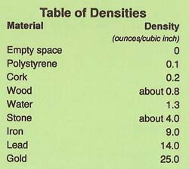

Data Handling
Reentering data all the time could get tedious for the user.
The data can be read in from a file

Slide 30

Process of Writing data into a File
Finding your car in the park lot
(defining what file in the hard disc)
Open the car door
(opening the file to write)
Let the woman go inside
(write the data into the file)
Close the door when she is inside
(close the file after writing all the data)

Slide 31

Process of Reading data into a File
It is the same process !

Slide 32
Types of File

Slide 33
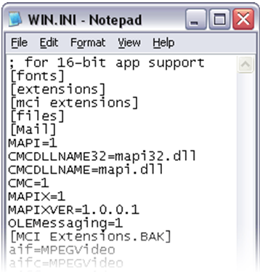
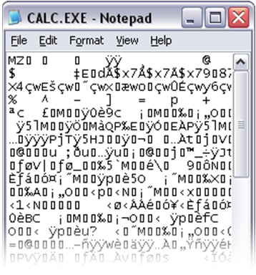
Two Types of File
Text Data
(you can easily read)
Binary Data
(only some programs can read)

Slide 34
Reading Text Data
From File

Slide 35
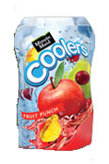

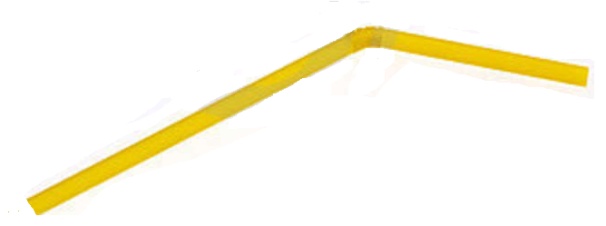
Reading Data From File
The Juice Bag is the Data File
We need a straw!
Your mouth is the program that wants the juice, opss, the data!
We want the juice inside it!
(We want to read the data)
open a data stream between the file and your program
How do we do that in real life?

Slide 36


The straw can be very long
But remember, with the invention of internet, We might be opening a file that is located in the other side of the world!

Slide 37
Reading Data From a File
In this course we will use the File and Scanner classes to read data from a file:
Pass the name of the file as an argument to the File class constructor.
The juice box (the data file)
File myFile = new File("Customers.txt");
Scanner inputFile = new Scanner(myFile);
The straw (the data stream)
Pass the File object as an argument to the Scanner class constructor.
Scanner inputFile = new Scanner(new File("Customers.txt"));

Slide 38
Reading Data From a File
  Code Example:
  // allow the user to enter the file name via keyboard
  Scanner keyboard = new Scanner(System.in);
  System.out.print("Enter the filename: ");
  String filename = keyboard.nextLine();
  // get a reference to the data file
  File file = new File(filename);
  // get a data stream (straw) that connects your file
  // contents with your program
  Scanner inputFile = new Scanner(file);
  // Read a line from the file.
  String str = inputFile.nextLine();
  // many other methods can be use to extract data: nextLine, nextInt,
  // nextDouble, etc.)
  // Close the file.
  inputFile.close();

Slide 39

Question
How would I read all the contents of the file, instead of just one line?
See FileReadDemo.java

Slide 40
Writing Text Data
Into a File

Slide 41
Writing Text To a File
Step #1:
To open a file for text output you create an instance of the PrintWriter class.
PrintWriter outputFile = new PrintWriter("StudentData.txt");
Pass the name of the file that you wish to open as an argument to the PrintWriter constructor.
Warning: if the file already exists, its contents will be erased

Slide 42
The PrintWriter Class
The PrintWriter class allows you to write data to a file using the print and println methods, as you have been using to display data on the screen.
Just as with the System.out object, the println method of the PrintWriter class will place a newline character after the written data.
The print method writes data without writing the newline character.

Slide 43
The PrintWriter Class
Open the file and get a stream
PrintWriter outputFile = new PrintWriter("Names.txt");
outputFile.println("Chris");
outputFile.println("Kathryn");
outputFile.println("Jean");
outputFile.close();
Close the file
Write data to the file

Slide 44
Appending Text to a File

Slide 45
Appending Text to a File
The Juice Box!
The Straw!
To avoid erasing a file that already exists, create a FileWriter object in this manner:
FileWriter fw =
new FileWriter("names.txt", true);
Then, create a PrintWriter object in this manner:
PrintWriter fw = new PrintWriter(fw);

Slide 46
Specifying a File Location
On a Windows computer, paths contain backslash (\) characters.
  PrintWriter outFile =
  new PrintWriter(“C:\\PriceList.txt");
On Unix/Linux the file paths contains forward slashes (/) to separate directories:
  PrintWriter outFile = new
  PrintWriter("/home/rharrison/names.txt");

Slide 47
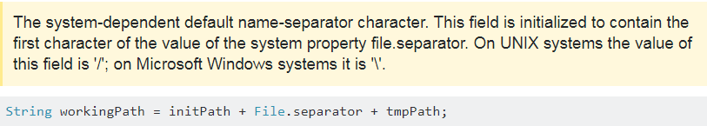

Slide 48
Exceptions

Slide 49

Reading Data From File
Choose the juice box
The stream line that will connect the file and your code
Your code

Slide 50

Picking up a file can be risky!
If we try to read data from an inexistent file the program will crash!
We might be opening a file that is located in the other side of the world!
How can we handle this situation?
This operation is very risky! The file might not be there at all!

Slide 51

Things to think about
Is it possible to know (as programmer) during development time if the file that the user will specified in his input exists during run-time?
This will cause an run-time error (or exception) that can cause your program to crash!
There are ways of preventing your program to crash!
See ReadFirstLine.java

Slide 52
Handling the unknown
When something unexpected happens in a Java program, an exception is thrown
The method that is executing when the exception is thrown must either handle the exception or pass it up
To pass it up, the method needs a throws clause in the method header.

Slide 53
Passing Exceptions Up
To insert a throws clause in a method header, simply add the word throws and the name of the expected exception.
PrintWriter objects can throw an IOException, so we write the throws clause like this:
  public static void main(String[] args) throws IOException
See ReadFirstLine.java

Slide 54

Any Questions?

